Slide 1
Citi Lead Wireframe Workflow

Slide 2
Lead Origination and Transmission
Agent generates own lead and provides to Citi for pre-approval
Lead Insert API (work around)
Citi receives pre-approval lead from non-listing page to route directly to an agent (lead does not have a Realtor)
Lead Insert API
MC Website Leads – (non-listing pages)
Widget – TBD
Contact Form – TBD
Agent Website Leads – (non-listing pages)
Widget – Citi would have to develop a process for linking the lead to the agent
Contact form – TBD
Lead comes from Citi ad on Non-KW IDX listings – TBD
Lead comes from Citi ad on KW IDX listings – TBD
Lead comes from Citi ad on KWLS listing - TBD

Slide 3
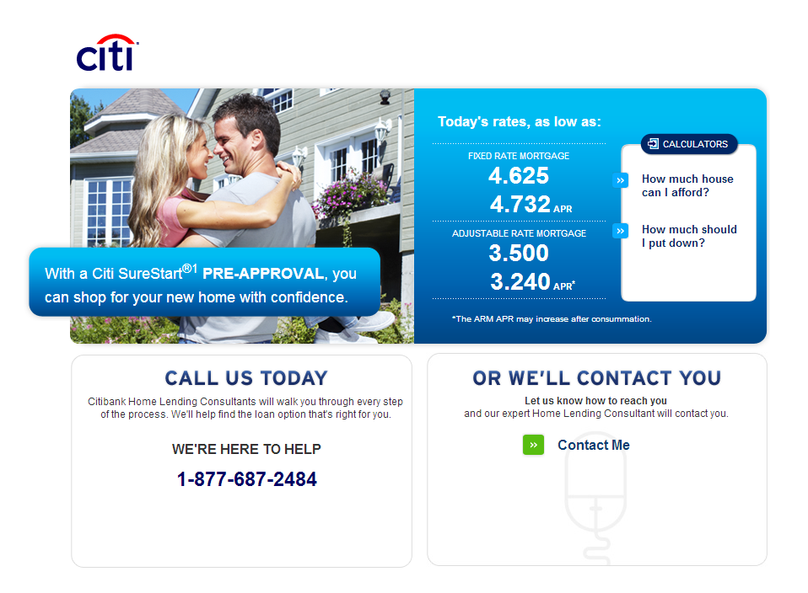
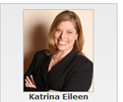
Agent generates own lead and provides to Citi for pre-approval
Agent manually emails lead information to Citi’s Premiere Lending Desk
Citi communicates back the status to agent via Lead Insert API
Requires KW development of process (work around) to re-route update as an email to the agent
Development time: _________
Today’s capabilities – Agent to email PLD, Citi email agent back directly (no KW development)
This will not show as a Citi lead source in performance metrics
Agent
Email
Consumer

Slide 4
Lead Insert API
Citi receives pre-approval lead from non-listing page (lead does not have a Realtor)
Citi wants to send lead directly to opted in agents in Market Centers who have an MSA via lead insert API
How do agents opt-in to receive leads?
How does Citi determine which agent receives lead?
What if lead is in a location where no MSA exists?
This will show as a Citi lead source in performance metrics
Steps to launch
Provide Citi with agent data
Test API
Citi will need to add “Do you currently have a Realtor? If not, would you like us to have one contact you” language.
KWRI API
Agent
Consumer

Slide 5
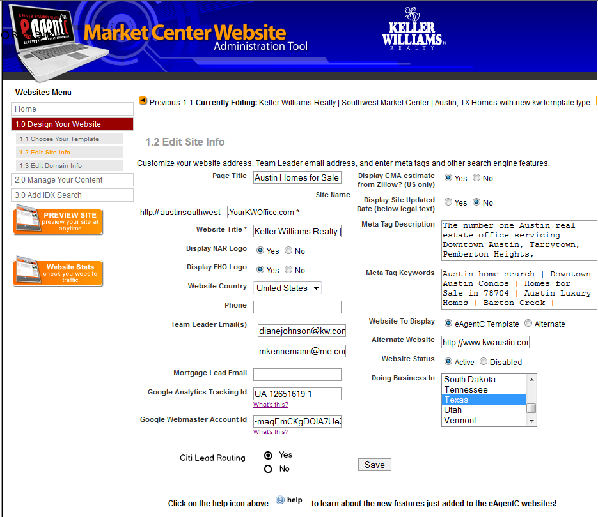
3. Market Center Website Leads – (non-listing pages)
All Market Centers will be opted out by default
Two lead generating actions:
Get pre-approved/current rates widget
Citi widget will be ready in Q4
KW MC contact forms
Market Centers will be able to opt-in lead sharing with Citi from contact forms here
Lead will not go through Lead Insert API if it goes directly to Team Leader
Do not have a solution for connecting Citi to Agent
Requires KW development of adding Widget and Citi info to contact forms on MC Website Admin
Development time: _________

Slide 6
3. MC Website leads go directly to the Team Leader for distribution – (non-listing pages)
3. A) Get pre-approved/current rates widget
1. Citi widget will be ready in Q4
Lead will not go through Lead Insert API if it goes directly to Team Leader
Do not have a solution for connecting Citi to Agent
Requires KW development of adding Widget and Citi info to contact forms on MC Website Admin
Development time: _________
Team Leader
Agent
3. A)
MC Website Widget
Consumer

Slide 7
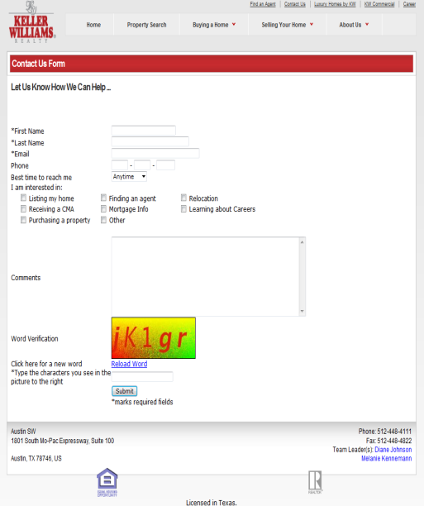
3. MC Website leads go directly to the Team Leader for distribution – (non-listing pages)
3. B) KW MC contact forms
Lead will not go through Lead Insert API if it goes directly to Team Leader
Do not have a solution for connecting Citi to Agent
Requires KW development of adding Widget and Citi info to contact forms on MC Website Admin
Development time: _________
Team Leader
Agent
Add get pre-approved check box
3. B)
MC Website Contact Form
Consumer
Agent

Slide 8
Lead Insert API
4. Agent Website Leads - Agent opts-in to Citi Get pre-approved or current rates widget on own website (non-listing pages)
Requires KW development of adding Citi Widget on Agent Website Admin
Citi widget will be ready in Q4
Development time: _________
Status updates of pre-approval from Citi will go through Lead Insert API (work around)
Requires KW development of process to re-route update as an email to the agent
Development time: _________
Today’s capabilities – Citi email agent back directly (no KW development)
Citi will need to develop way of knowing which agent site lead came from – will use lead insert API
Citi inserts new lead into API
Would this be considered a Citi lead? Would show Citi as lead source in performance metrics
If lead is already in Agent’s eEdge, system will choose work around (KW Development – see 2. Status updates)
Today’s capabilities – Citi email agent back directly (no KW development)
This will not show Citi as lead source in performance metrics
4. Steps to launch
API functionality
KW Development of adding widget to admin
Citi widget development
Agent
Consumer on agent site
KWRI API

Slide 9
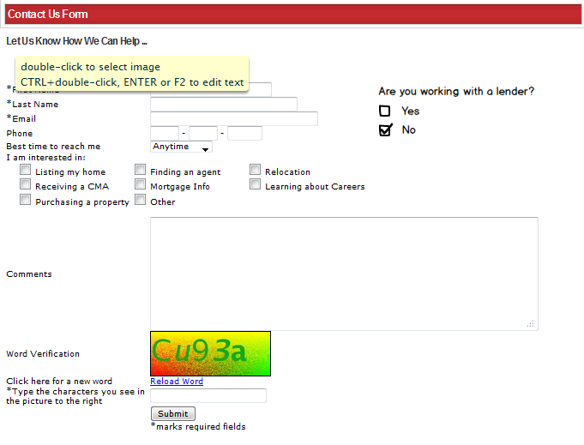
4. Agent Website Leads - Agent opts-in to Citi receiving lead info from contact forms on own website -- TBD
**Exact verbiage and logo TBD

Slide 10
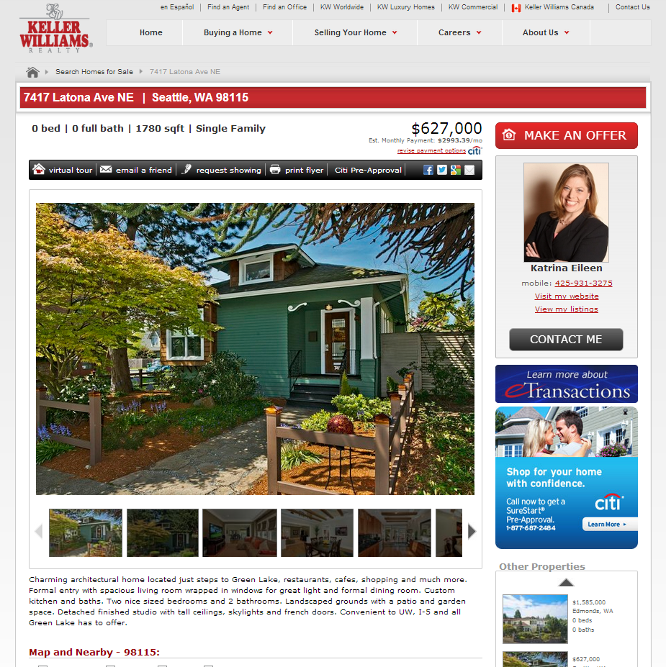
7. Lead comes from Citi ad on KWLS listing -- TBD

Slide 11
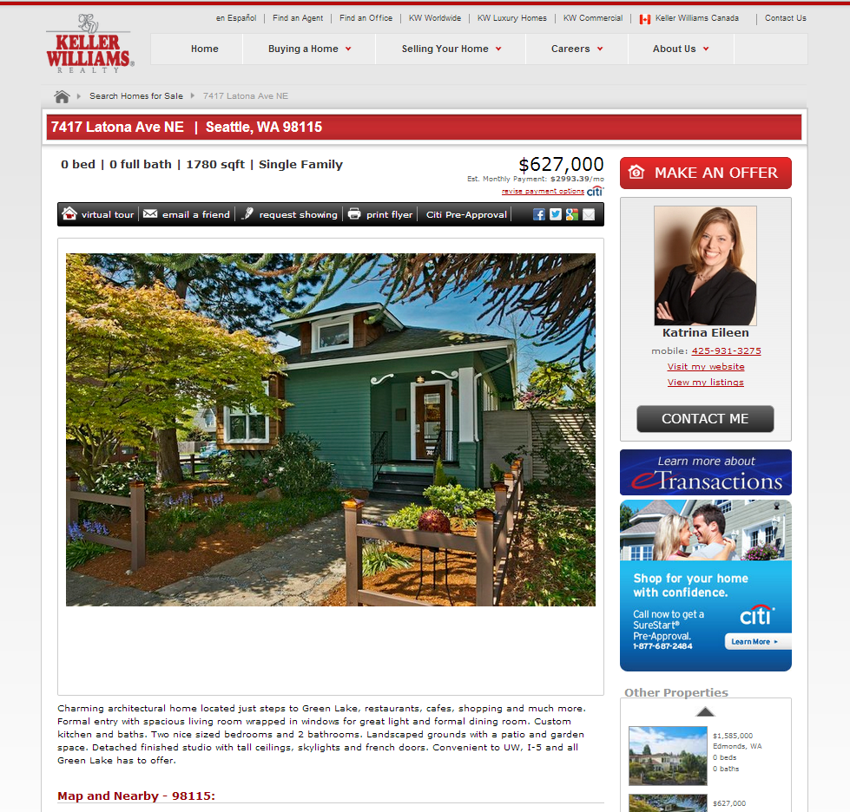
7. Lead Workflow
KWRI API
Agent
Consumer

Slide 12
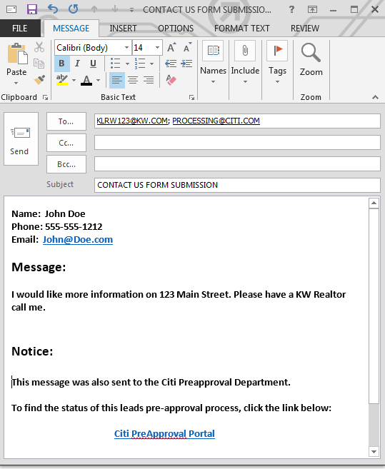
How: Email Workflow
Broker
Email from contact form sent to Agent from Market Center
Agent
Citi Preapproval Status
Agent clicks link in email to be linked to lead info in Citi’s SalesForce system
Pre – approval status milestones to agent
Pre – approval to client
Touches to client

Slide 13
Where: kw.com (KWLS Listing Pages)

Slide 14
How: Lead Workflow
KWRI API
Agent
Consumer

