Slide 1
Program Review:
Content Operations &
Content Acquisition

Slide 2
Who we are.
Content Operations:
24hr. delivery of eligible companies for Indeed.com, not yet seen by Content Acquisition
24 hour lead delivery in 21 markets: AU, IN, JP, DE, GB, BR, CA, IT, ES, NZ, PH, HK, SG, SE, PL, FR, NL & US - from 58 Sources
AGG delivery for (63) markets (Manual AGG for (9) initiatives and (7) markets - of images, flash-based, job fairs, etc)
Partnership with AGGOps (2017)- helped to build workflow management TTurkey (SCOUT, SPROUT & Job Post)
One Content Workflow (2018)- defined segmentation & process automation points
Partnership with TBA “Compete” Team (2017) for automation development
Performance & Impact:
Year Company Conversions (coincides with market launches)
2015 12,126
2016 44,206
2017 127,615
2018 142,252
2019 164,076 - projected for current markets
Natalie ** | Director
Patric ** | International Content Operations Senior Manager
Eva ** | International Content Operations Manager
Flavia ** | International Content Operations Manager
Linda ** | Content Operations Functional Lead
Aino ** | Content Operations Functional Lead
Shelly ** | Content Operations Training Manager
Matheus ** | International Content Operations Manager
COPS ** | (12) - by Market
COPS ** | (3)
Vendors | (210) - by Market

Slide 3
Who we are.
Content Acquisition:
2014 - C.A. launched in Oct 2014 in Australia
2017 - tested the use of an offshore BPO vendor to call & convert in PH.
2018:
24 hour lead delivery for 18 markets with COPS
Leads checked & rejected by callers reduced from 22% to 7%
Conversion rate increased from 25% to 46%
Converted & posted jobs for 142,246 companies globally
Launched Re-engagement in AU
Expanded our BPO activity by introducing “Prospecting “ - allowed in-house callers to increase total calls by 14%
2019 -(Q1) Sales Partnership (test), calling companies currently assigned to Sales - with jobs on competitors sites, not on Indeed
SLT Presentation 2017
SLT Presentation 2018
Natalie ** | Director
Brandy ** | Content Acquisition Manager of Americas (Interim Sr. EMEA Manager)
Simon ** | International Content Acquisition Senior Manager
Yuto ** | International Content Acquisition Manager
Antoine ** | International Content Acquisition Manager
Shonale ** | International Content Acquisition Manager
In-House Acq. Reps | (48) as of Q2, 2019
BPO Callers | (40) as of Q2, 2019
In-House Support Reps | (37) as of Q2, 2019
Notes:
**Only applicable to AU

Slide 4
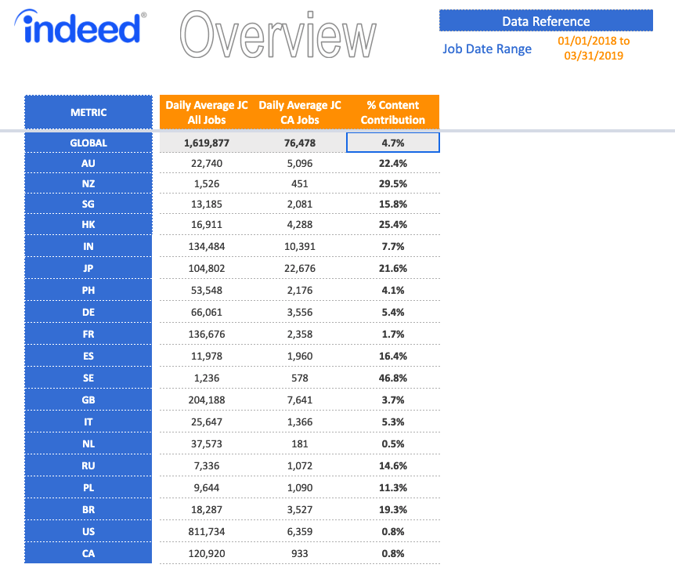
What we contribute (Content Acquisition)
Source: COPS Analyst Team - Methodology

Slide 5
KPI - Long Term Value
Metric | Description | Data Source
CA Revenue Generated | All revenue including that generated prior to conversion (excluded in the next step by comparing to CA Conversion Date) | IQL Query
CA Conversion Date | Used to exclude revenue generated prior to CA Conversion | IQL Query
True CA Revenue Generated | Excel used (due to data size) to exclude revenue not associated to CA | XLS File
LTV (Rev per Acquisition) | Calculated by dividing total revenue in 24 month period by total conversions in 12 month period | Revenue Metrics Tab
LTV 2 year study

Slide 6
We are Human-powered,
Spreadsheet-driven,
...and seeking automation.

Slide 7
Where are we now? (Every 24 hours, for 63 Markets)
Content Operations
Company Name Search & Collection
Collect companies through IQL or manual collection with vendor
Pull companies on job-boards through Waldo
Export Data & Create JIRA Ticket
Cleaning & Deduplication
Newcleaner.py script run against IQL export to “normalize” and dedupe against “Bones” vendorops table
Serp-derp.py script dedupe against AggTest
Copy Paste to local Google sheet 1) Fuzzy Vlookup run against (antimaster) for spam check 2) Exact lookup run against (Caller Leads) list
Repository & Recycling
Vlookup matches from above - vlookup again against recycling pool (list of jobs that disappeared momentarily) on Caller Leads
Enrichment
CSV Upload new companies to TTurkey and contact vendors
Vendors perform research and update company data (automatically sends to LEW (AGG) if > 10 jobs)
Generate New Company List & “Calling Leads”
Download enriched leads from T.Turkey
Copy to local Google Sheet masterlist
CSV Upload through Havarti platform
Assign to C.A.
Copy to new “Calling Leads” Spreadsheet
Upload to JIRA ticket (above) - add comment with counts.
Content Acquisition
Prospecting & Converting
Regional Manager manually sorts “Calling Leads Sheet” and allocates for qualifying & ranking
Call & Convert (Indeed & BPO)
Callers fill out conversion form
CSV Upload of converted leads to AdCentral for Prospect Card
Job Posting
TTurkey - Vendor assisted job post workflow with Content Support Analyst
Ad Central - Content Support Analyst manually research each job for integrity and completes AdCentral data requirements
Job is submitted and posted to Indeed.com
Reporting
Based on Rep Sheet (CRM-like) Google sheet
Performance rolls up to Conversion Dashboard Google Sheet (Rep Sheets)

Slide 8
Active Markets Reporting Map
Market | Conversion Dashboard | Admin Sheet | Responses Sheet | Calling Leads Sheet
AU Re-Eng | https://docs.google.com/spreadsheets/d/1oCwJlRsI8LeSeaI18DIkYrdu5tSAuv9Us--R-g2vO68/edit#gid=773130465 | https://docs.google.com/spreadsheets/d/1cuHNk0uefpUEBhf6puLFjdui7DqUTu4YiiHaJ5VpUBU/edit#gid=1438439112 | https://docs.google.com/spreadsheets/d/1cKEWpKveWTweYJR7xmNrpHh0Z-DplAFoFCK9tn4Cq9A/edit#gid=2771340 | https://docs.google.com/spreadsheets/d/18q15gfl28BbMmRvATybqo1FMwjU7fKwTb8rnxPFaYzM/edit#gid=1980912882
BR | https://docs.google.com/spreadsheets/d/1b8W0WFlBV3CE8RQrjov97_UaabOuaUm6itLQOq9iupk/edit#gid=1349314138 | https://docs.google.com/spreadsheets/d/1hz8ZeOoRGFjDzYaso8BqTTbwsG3T-eVWq8uCkiHgpRo/edit#gid=569905745 | https://docs.google.com/spreadsheets/d/1Sl2iOn8nwD850rVkUNmFmHOd8STqO3yKaEItUqmxMgI/edit#gid=2771340 | https://docs.google.com/spreadsheets/d/14eNnsqFRURw_9Sz3McQCnHVXzqpwgXLOTMA72aCTlcI/edit#gid=1611175856
CA | https://docs.google.com/spreadsheets/d/1gO_4coJXF7zNRhewmM_RuYBn_SoLgKpzwWkeIRoEN8g/edit#gid=1349314138 | https://docs.google.com/spreadsheets/d/15RHLpSpdeX0wJRoL_V2ZHB9yrt4DoMKqPTJ7ciym0AE/edit#gid=26767660 | https://docs.google.com/spreadsheets/d/1fKeT5v0aQ70QiaiQN_dycSgqq3_cmu4SGFzvqiABBtM/edit#gid=2771340 | https://docs.google.com/spreadsheets/d/1bS-gky85Rm8mWlIPYhZHxU_Oj9ipBuEhcxtOhc3El54/edit
DE | https://docs.google.com/spreadsheets/d/1Mvv27AyMmSV2xCNXDwKTU3_5GvPQr7uHWYgYliNCiCU/edit#gid=773130465 | https://docs.google.com/spreadsheets/d/1vct69HNRh6YpRMZnY66SHI7I-iQKEctu6GML1J7t19E/edit#gid=1438439112 | https://docs.google.com/spreadsheets/d/1dncQryTDEdK_xass-O4GE0DxZpr5Y2zMlvsCS26QZEw/edit#gid=220120442 | https://docs.google.com/spreadsheets/d/1oNzzbsKeChB-51nzh7BmD7XmtB-tlAmBTnic9vkK7h4/edit#gid=1442095736
DE BPO | https://docs.google.com/spreadsheets/d/1G8igpv55XGWvNekM_a1GlEDRY7oTrGchXhBZTWvxtio/edit#gid=1349314138 | https://docs.google.com/spreadsheets/d/1VS98ZqshWNM2a8bMkgeLxcDaT4sZi7D9d8o378O3EKs/edit#gid=569905745 | https://docs.google.com/spreadsheets/d/1dncQryTDEdK_xass-O4GE0DxZpr5Y2zMlvsCS26QZEw/edit#gid=220120442 | https://docs.google.com/spreadsheets/d/1oNzzbsKeChB-51nzh7BmD7XmtB-tlAmBTnic9vkK7h4/edit#gid=1442095736
ES | https://docs.google.com/spreadsheets/d/1VAmiTDwUNjVGNow839s0_nZ8T30Vg-Y9E9gn2CwZ40U/edit#gid=773130465 | https://docs.google.com/spreadsheets/d/1RTIQF7mlU5HQqVw0g6VrIk2wPuZCRarLdjdPu4plk8c/edit?usp=drive_web&ouid=110750703352970627670 | https://docs.google.com/spreadsheets/d/130-0ORGQGkK92xwloQ8culupBv9BGJYrXCJh-jxIE0g/edit#gid=1275994363 | https://docs.google.com/spreadsheets/d/1-ZqUm7KIsFfQjPc3FolYh_mT8YbR7YgQUVIxA5gykWg/edit#gid=306282350
FR | https://docs.google.com/spreadsheets/d/1x3C7HQE0g8gKW-rLBZDIlfrswqDkER-7c4pgjVy1O5k/edit#gid=1349314138 | https://docs.google.com/spreadsheets/d/1JoiY7YvfZvCMzyTYKSD0jCGGY5BPOlg99YNH3UUQ9jM/edit#gid=1188929572 | https://docs.google.com/spreadsheets/d/1WSumB9CIC0WyEO6NWoWicE-QPWYCRKQUFBVXYbvIwfM/edit#gid=220120442 | https://docs.google.com/spreadsheets/d/1H0TN88bmMpwPUNb49Td5lPS5NTqLBkTgusWMSOq2a0M/edit#gid=306282350
FR BPO | https://docs.google.com/spreadsheets/d/1a-qW8iM0v3MeVvW7pAi8zV-IMUA-zknvgP6hPBg0s_A/edit#gid=1349314138 | https://docs.google.com/spreadsheets/d/1vTKjnj_HYadtfGxhUCl6VAOT8DjiVLe2D_iZX35h0AQ/edit#gid=1188929572 | https://docs.google.com/spreadsheets/d/1WSumB9CIC0WyEO6NWoWicE-QPWYCRKQUFBVXYbvIwfM/edit#gid=220120442 | https://docs.google.com/spreadsheets/d/1H0TN88bmMpwPUNb49Td5lPS5NTqLBkTgusWMSOq2a0M/edit#gid=306282350
GB | https://docs.google.com/spreadsheets/d/19GMTacTqXpxofAH5SqBjBx4cTmxGluCJuhUSRZAP6Ik/edit#gid=1349314138 | https://docs.google.com/spreadsheets/d/1W8a96eDEN3VjwTKzZswYqSqTa6S_kmbXwyK5uSrWxF8/edit#gid=1206711340 | https://docs.google.com/spreadsheets/d/1lmCoAnreN9xFKJrs3_DYaTAK8ILEXQPD4a4fQ6lBJpI/edit#gid=2771340 | https://docs.google.com/spreadsheets/d/1YTiy1T3rl7uX5SdVUMCSnjPqqaVrPYCtV1E41Vk68g0/edit#gid=2073444783
HK | https://docs.google.com/spreadsheets/d/1E2OFw0LDEKHe5TFJrGnnRd8cccrxxc2gvynLS6z_SKM/edit#gid=1349314138 | https://docs.google.com/spreadsheets/d/1-Buq9mN63bmFX_bP0DJ8xRIHGS_K6TcxeKoAwMzlOEk/edit#gid=569905745 | https://docs.google.com/spreadsheets/d/1Wjt2g9CQYWwjd8QlumtxVz-prVqmt17oILDN2leSjDQ/edit#gid=220120442 | https://docs.google.com/spreadsheets/d/1Hw64ySHozg8cQSucAlqGkdSWs8I8DIspf-OuiEO6n_Y/edit#gid=306282350
IN | https://docs.google.com/spreadsheets/d/1iXzNwxixUpnK2T2H__XRcdbMgHSMsxWmQsfTygnRY54/edit#gid=773130465 | https://docs.google.com/spreadsheets/d/1nJHPccUn-_JEZwEaQc7zP6djyr33zX1-Z7V2tFbnGTg/edit#gid=569905745 | https://docs.google.com/spreadsheets/d/1zc-yYoYqd7qo5qBEVHqiW6cz23TST95-VFLdGMDosdc/edit#gid=220120442 | https://docs.google.com/spreadsheets/d/1bpwPfb3nj55WR7V58clj_Ot5s-vsghC_uRK_Y0vXdAU/edit#gid=1280375475
IT | https://docs.google.com/spreadsheets/d/1kDN-KGHCou2rMbd9y7ZpfHdKy8LCgmtev6bAY8_1xJQ/edit#gid=773130465 | https://docs.google.com/spreadsheets/d/1jbHm2MjqDqtS2MTAuXXdOlfGubKcGFaFJh8XiKlidAA/edit#gid=1605383994 | https://docs.google.com/spreadsheets/d/17pMlLncZvqzESBsz0w-qhq-2-s68GF7HxmpV_xIaie4/edit#gid=2771340 | https://docs.google.com/spreadsheets/d/1InALmiQHOY9wiX1TQ3u33dfOR3tes8DrQZlfd2B_tR4/edit#gid=306282350
JP | https://docs.google.com/spreadsheets/d/1lFlB7KF7-FkLJaOA_ZdwjwlHIGIRHnQTbN4YtA9khrM/edit#gid=1349314138 | https://docs.google.com/spreadsheets/d/18e6gDxd7c50HR_f9k0jc46UwS8k5n3W03-cm65a8kio/edit#gid=569905745 | https://docs.google.com/spreadsheets/d/1fuj6VUNqLO5vyx0Z4WO--0rVjDxS57Ty9SdwXICGCmU/edit#gid=220120442 | https://docs.google.com/spreadsheets/d/1JTB4v-FZXsKYTVrdAZmD_5qGtCcpsimqGFGWgXgW0zo/edit#gid=306282350
JP BPO | https://docs.google.com/spreadsheets/d/1SZjqwLJY9MNQYqslnvQ-Wvm__7f5e0-LINrzn1LdyyY/edit#gid=773130465 | https://docs.google.com/spreadsheets/d/1P_JKGkOg1m4IeB_oU---VINr6DmhtmEskTgZq_UEb8k/edit#gid=1188929572 | https://docs.google.com/spreadsheets/d/1fuj6VUNqLO5vyx0Z4WO--0rVjDxS57Ty9SdwXICGCmU/edit#gid=220120442 | https://docs.google.com/spreadsheets/d/1JTB4v-FZXsKYTVrdAZmD_5qGtCcpsimqGFGWgXgW0zo/edit#gid=306282350
NL BPO | https://docs.google.com/spreadsheets/d/11J3QEtwav6o53orINOfeTRih4kd8wkl2jNMtH0vbjmA/edit | https://docs.google.com/spreadsheets/d/19MjbISqoIZCWMd6P3OWqCcg4nk4L36DSz0a1p_PbbTk/edit#gid=2095941886 | https://docs.google.com/spreadsheets/d/1TuWNohgKc48TYIbN1V8yVEN0Wpzz_zN-DcMDihtfaao/edit#gid=220120442 | https://docs.google.com/spreadsheets/d/14DduXKOut-VBLc5dJDYHqp67_lFdZKxFKAgZXf6ngkM/edit#gid=306282350
NZ BPO | https://docs.google.com/spreadsheets/d/1fQgTCgLzOVIJYVa7UUwDclneRGuw6uiDAlbqQ8Cqo00/edit#gid=1349314138 | https://docs.google.com/spreadsheets/d/1yKDAHjlFxCzfB-Q1rbkZ6gQdLa8Dp-cZ1R9H1y6bbc0/edit#gid=569905745 | https://docs.google.com/spreadsheets/d/1hDjnGlW7x86879tUtmsQ0jMWFeZ8gz2XZ47u72wz_zM/edit#gid=1896084342 | https://docs.google.com/spreadsheets/d/1fL5aA1J1zPKfuzXK3it0vf-7w1rC1b4Ta7k_w0AMnl0/edit#gid=306282350
PH | https://docs.google.com/spreadsheets/d/1zSI7aPNKwvkvZlWfky4nq8o2n2DEXfLFfnQcQL-OBQY/edit#gid=773130465 | https://docs.google.com/spreadsheets/d/1rT-iOR5EUEEx4Qk9DbyKGMspIXcgfsWmPwdSNeVPaEU/edit#gid=26767660 | https://docs.google.com/spreadsheets/d/1PDu6SnI769cBWzmDQK51STxfCSmIbYQ415xb5Em0UUE/edit#gid=1896084342 | https://docs.google.com/spreadsheets/d/1OHvnKs3_5EvJPu5vdMoBAoTmFUwr6LtLBzgB7V4mqNc/edit#gid=306282350
PL | https://docs.google.com/spreadsheets/d/1x4mtn0kj5QV4dxR010bVpmmEGjkOAK29grAkneRs_hI/edit#gid=773130465 | https://docs.google.com/spreadsheets/d/1zQxIywKzsm3aQSvkYHANqofh0C-ImJNw5BrIGwfB-9Y/edit#gid=26767660 | https://docs.google.com/spreadsheets/d/1PfYQVVuXJqDAxjSP6IR2JdmRUEq5qNL3hp-3H94puNA/edit#gid=220120442 | https://docs.google.com/spreadsheets/d/1EFzgQlRyYWlpEwDLTTBGkhJlmZ67jV9pncv6negoOb4/edit
SE | https://docs.google.com/spreadsheets/d/1bPFR26GpUIylfLcJTSd85kohvwISmF-Mkeo9G08zu2A/edit#gid=773130465 | https://docs.google.com/spreadsheets/d/1ufs_Vgd6Crha66FWqenJedgOSg0-EdbFyYgW3b61mKc/edit#gid=1188929572 | https://docs.google.com/spreadsheets/d/1HWS9PWCsSO1RwaGOTzc_Zy2lNd7LhRidmy14fmmbmiU/edit#gid=220120442 | https://docs.google.com/spreadsheets/d/1FQUJEwd4J6_qYmUdwDcSwnnOEmwhRBmWEvfcLbpn08I/edit#gid=296462178
SG | https://docs.google.com/spreadsheets/d/1nrRlOLiZcSarreAEOTUGhfWG0ffif3FvyigisGo7FRk/edit#gid=1349314138 | https://docs.google.com/spreadsheets/d/1Ey2ZfFqyV3nrRzHn35GYJZYCex0_yHBrTiBidzqOrOI/edit#gid=569905745 | https://docs.google.com/spreadsheets/d/1vwv04UY6yiIVtPrYKhYSRe4A7WqueKmwRiIwBBo1ddM/edit#gid=2771340 | https://docs.google.com/spreadsheets/d/1YnTP82QkxAY-vNSqsRayU9LDOVesbov5j8064IlohbY/edit#gid=306282350
US BPO - TSL | https://docs.google.com/spreadsheets/d/1us32I1XGVLXHox7oK-aDyhog_RQbddAXzFAOmMuuPz0/edit#gid=1349314138 | https://docs.google.com/spreadsheets/d/1SReWqbnuosH8TQMYlOk072PTwJrplCow3GnzW_7pvok/edit#gid=1188929572 | https://docs.google.com/spreadsheets/d/1VL45GOxE8qtjXgcCjSri5dvFj2RUfH5Pu7bnnfFbmYI/edit#gid=1896084342 | https://docs.google.com/spreadsheets/d/15o5forXt-OcPEes7eRTFUhQymx7fs0zKm-9HqExZFDs/edit#gid=306282350
AU Sales | https://docs.google.com/spreadsheets/d/1yA-V-MXppRkBYsDnpD7yV3Azd0Og082kqaV5TGIp9c4/edit#gid=1349314138 | https://docs.google.com/spreadsheets/d/1miplLjv1-iLtWOKIiLuEZzvHJ-PfNRkXA0QkzKXywv4/edit#gid=1188929572 | https://docs.google.com/spreadsheets/d/1T_Z3v7ChBjUSrxgkadzpvLa2Rcfs2TeUi_rus5ai9Og/edit#gid=2771340 | https://docs.google.com/spreadsheets/d/18q15gfl28BbMmRvATybqo1FMwjU7fKwTb8rnxPFaYzM/edit#gid=1980912882
US | https://docs.google.com/spreadsheets/d/1YkbdNmsd3nGkOB5mj9rJPFdrklSEI8eKobj1kMc79kM/edit#gid=773130465 | https://docs.google.com/spreadsheets/d/1dtyVCzL0ozJ2Z0QwG51iSvnEBsZ34tJskIFGwZPF2sQ/edit#gid=1438439112 | https://docs.google.com/spreadsheets/d/1VL45GOxE8qtjXgcCjSri5dvFj2RUfH5Pu7bnnfFbmYI/edit#gid=1896084342 | https://docs.google.com/spreadsheets/d/15o5forXt-OcPEes7eRTFUhQymx7fs0zKm-9HqExZFDs/edit#gid=306282350
IN BPO | https://docs.google.com/spreadsheets/d/1-LJJv79y6jpH60FrxTCvM667HnELZ2qPIWGG0x3RnSI/edit#gid=1349314138 | https://docs.google.com/spreadsheets/d/1BRFUwXHeqcYzLMihAg3E4gzlxztEL9gWTR6Js2cSFxE/edit#gid=1188929572 | https://docs.google.com/spreadsheets/d/1zc-yYoYqd7qo5qBEVHqiW6cz23TST95-VFLdGMDosdc/edit#gid=220120442 | https://docs.google.com/spreadsheets/d/1bpwPfb3nj55WR7V58clj_Ot5s-vsghC_uRK_Y0vXdAU/edit#gid=1280375475
BR BPO | https://docs.google.com/spreadsheets/d/1fwrSunRQVhef840aEgyqyys7Ce0DESDEHwesS0MQLuo/edit#gid=1349314138 | https://docs.google.com/spreadsheets/d/1RPHK4ZuBxNvJI8I_VLjDnE_heijDmHnJdIwl6sxhXnk/edit#gid=1438439112 | https://docs.google.com/spreadsheets/d/1Sl2iOn8nwD850rVkUNmFmHOd8STqO3yKaEItUqmxMgI/edit#gid=2771340 | https://docs.google.com/spreadsheets/d/14eNnsqFRURw_9Sz3McQCnHVXzqpwgXLOTMA72aCTlcI/edit#gid=1611175856
US BPO - Tempe | https://docs.google.com/spreadsheets/d/16hvUHIBCveszrl0driYFrtrd92MtW7wvyx4w_n3O4yU/edit#gid=1847753359 | https://docs.google.com/spreadsheets/d/1vUVIdQuCaO0Jy6vaXuvh3oU3-AcIT5gnNqlGRttZies/edit#gid=2111882528 | https://docs.google.com/spreadsheets/d/11dHz1ZF0EwgsM-1ib_UqPg9SWMmbicDdjsFOzKlY_a0/edit#gid=2771340 | https://docs.google.com/spreadsheets/d/15o5forXt-OcPEes7eRTFUhQymx7fs0zKm-9HqExZFDs/edit#gid=306282350

Slide 9
Where are we going?
Automated delivery of missing companies identified on a competitor yesterday, onto Indeed today

Slide 10
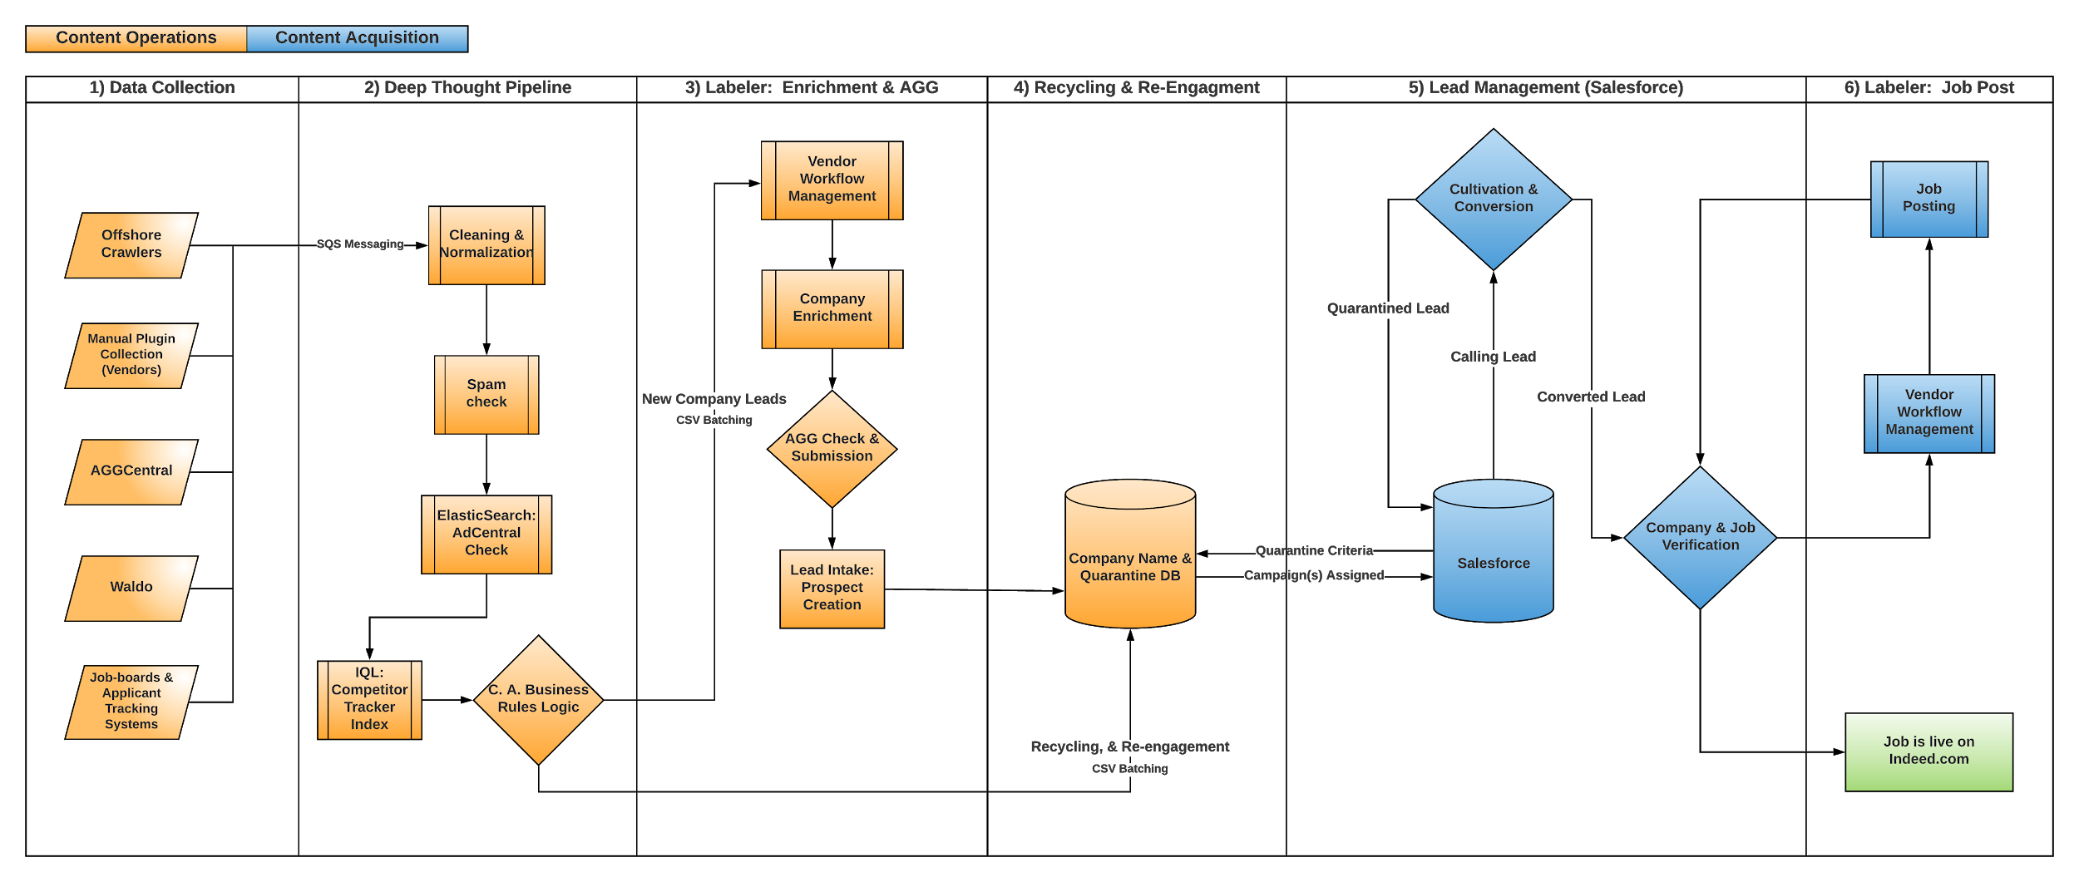
Where are we going? OCW.v2 - Re-plan: (6) Projects

Slide 11
Data Collection & Sources (AU, US, DE & IN)
Competitor Tracker & Intelligence Dashboard Report
Vendor crawlers - non-indexable sources, for legal reasons, including semi-manual collection with a browser plug-in, using keywords sets and SERP results
Offshore data collection - purchased data (28 of 60 sources ready)
Waldo - results filtered by market & predetermined, indexed competitors for COPS/C.A. purposes
AggCentral - Company’s indexed feeds
Other Indexed Sources: Agg3, joblist, job-boards, applicant tracking system that meet DALT (criteria): description, application method, location & title
Ad Hoc - TBD (e.g. Market Penetration Dashboard, Big Lists)
Processed by Deep Thought for log indexing, once an hour, to Competitor Tracker index
Rule #1
Delivery of missing companies identified on a competitor yesterday, on Indeed today

Slide 12
Deep Thought Pipeline
S3 - SQS Messaging System of (7) Microservices
Customized refinement and handling by market - accepts messages into pipeline as JSON
Purify - Title normalization & suffix cleaning - market & language-specific
Redis - caches to reduce load and manage redundancy
Comparison to Internal Data Stores:
Detective - Waldo queried - jobs on Indeed - or add job ID
3P0 - AdCentral CRM - Ad & Prospect ID lookup, Communicated to Elasticsearch
Dealer - Advertiser parent lookup & spend
Elephant - Additional C.A. Masterlist lookup (AU, JP & DE)
SortingHat - Logs published and indexed in Competitor Tracker
C.A. Business rules logic for programmatic filtering & routing
NOTE - A dynamic coverage feedback loop will improve prioritization of unique search terms as additional data is indexed in Competitor Tracker index. Future search term crawl frequency is then biased towards more effective terms.
Delivery of missing companies identified on a competitor yesterday, on Indeed today
Notes:
Resources: Selinium scrip, search terms & proxy list
Each enrichment component serves a single purpose, and ideally queries only one internal service. Each enrichment task consumes from one queue and publishes to another

Slide 13
Labeler (TTurkey Migration) Vendor Lead Enrichment & AGG Submission
Replan: TTurkey vendor workflow management tool deprecating - no support - process migration to Labeler
Labeler - Proposed Architecture
CSV Uploader - (16) Manual C.A. & (43) AGG markets
Watchdog API - Normalization
Deep Thought - SortingHat (only) microservice
Pre-processing microservices:
Lindy - Agg check
Waldo - active & indexed on Indeed
Redis - caching
Labeler check
Lew - Agg request check
Vendor enrichment program - joblist url?, careers page? Indexable?
Post-processing microservices:
Consul - healthcheck agent
Aggable? - Job Count > 1
Employer Intake - Create or Fetch prospectID
Index in IQL
Lead Distribution - CRM
Delivery of missing companies identified on a competitor yesterday, on Indeed today

Slide 14
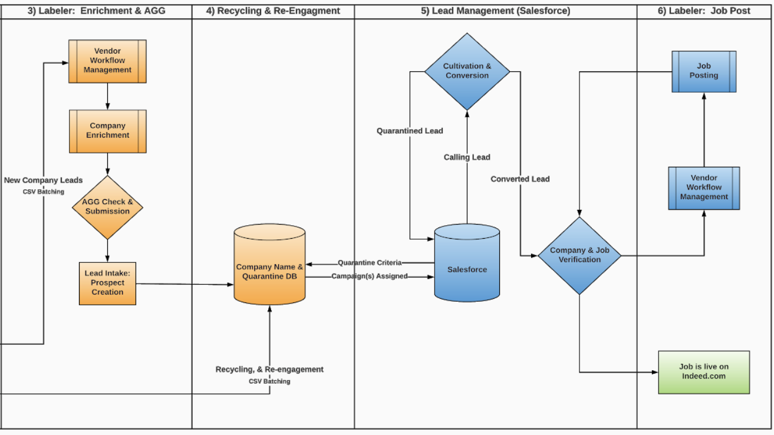
How will we convert & post jobs?
4) Recycling & Re-Engagement (Database & Logic)
Disqualification, Quarantine & Business Rules
Recycling - Surfacing of previously seen leads to callers
Re-Engagement - Enhanced business rule application
5) Lead Management (Salesforce)
Sorting, Routing & Prioritization of Caller Lead Queues
Rule-based Sorting & Allocation by Market
C.A. calling and conversion of jobs not on Indeed.com
6) Labeler: Job Post (TTurkey - Process Migration)
Conversion verification by Content Support Rep
Workflow management queuing for job post by vendors
Content Support Rep job post validation
Job submission to Dradis

Slide 15
Gaps.
COPS
Data is at risk (Legacy Systems - Havarti, Locally Saved Sheets, Human Error, Lack of Redundancy)
Scripting latency for large datasets, manually run slows job collection - e.g. Havarti & VendorOps db
Skillset - COPS associates are not project, product managers or business analysts
Workload - Day-to-day operations + regional collection scheduling (time of day) + project management
Attrition
Talent with market expertise and technical capabilities
Examples: Dutch role open for 12mo - Must speak Dutch for QA of company data
Dependencies on other Business Groups (Examples)
CRM/BAT - SFDC Rollout
AggOps: Recrawl Research - Recycling of previously disqualified domains in LEW
AggOps: Recycling in T.Turkey of previously seen companies in AGG
Time - Manual crawl & processing of company data generates less volume for Agg & C.A.
C.A.
Change Management for Callers, Support Reps & Market Leads
Markets, Languages, Platforms, BPO Prospectors/Callers, Local Legislation & Compliance
Awareness & training of process changes, reporting changes & bonus-driven goals
Training Documentation Creation

Slide 16
Program:
Impact:
Cross Collaboration & Team Alignment (other Programs)
Proved out end-to-end concept & project feasibility between teams
Involved all stakeholders (never a meeting between development and operations)
Grounded project expectations (single interpretation of project goals)
Executive support and signoff of revised goals
Requirements gathering, elicitation & change management process
One source to maintain control and develop against
Communication:
Meeting notes, Weekly Project(s) digest, Monthly updates (Hudson email)
Meetings: Leadership Update & Scrums (2)
Documentation:
Wiki (Program & Project), process flow, logic gate mapping (Deep Thought Routing - Business rules)
Business Analyst Team assistance (documentation during Deep Dives)
Training:
Product Lifecycle & Process (Deep Dive, requirements gathering, estimation, scope)
Project Management Training
JIRA (full platform feature & function)
Roadmapping & Timeline Coordination
Ad Hoc: Havarti Project (workaround and deprecation

Slide 17
Program (Before & After):
Natalie's KPIs
Top Level KPI:
Missing Jobs % of Competitor Jobs
Team specific KPIs:
Ops
# of jobs added for all channels our team can influence (C.A., Agg, Man Agg, Jobspotter) see infographics here.
% of job contribution that we are responsible for
Employer response / mutual engagement to ensure quality jobs are being added
Cost, ROI & LTV on each channel
C.A.
# of conversions / jobs added
# of conversions / jobs added within 24 hrs of being identified on competitor site
Employer response / mutual engagement to ensure quality jobs are being added
Cost, ROI & LTV
Development & Feature impact analysis:
Data Coverage
24 hr lead delivery impact on efficiency rate - assess difficulty and accuracy of methodology
Time and cost savings analysis
Deep Thought
Time and cost savings of decreased disqual rates?
TTurkey enrichment
Salesforce / Shuri
TTurkey for job posting
Time and cost savings
Product & Finance interference
Graham’s KPI’s
KPI | (BEFORE) Manual processing → (AFTER) Automation
SIZING:
 | TIME SAVED
 | COST BENEFIT - $$ SAVED
CONTRIBUTION:
 | % AND COUNT OF TOTAL JOBS
 | % AND COUNT OF TOTAL AGG
VELOCITY:
 | COMPANY/JOB ACQUISITION SPEED BY MARKET
 | TBD - Time Repurposed - (e.g. New Market Exploration)

Slide 18
How much longer?
Data Collection & Sources (US, AU, IN & DE) - Complete
Deep Thought Pipeline Automation - Complete
Labeler (TTurkey Migration - SCOUT) - Planning - Keep Watch
Lead Routing & Prioritization - On Hold
Lead Management (Salesforce) - Planning - Keep Watch
Labeler (TTurkey Migration - SCOUT) - On Hold

Slide 19
Questions?

