Slide 1
A Primer to Agile, (In One Hour)

Slide 2
Learning Agile is Stimulating
Ideas will Flow!
We are accepting applications of Agile at GT & PHX! There is a large-scale transformation taking place
Servant-leadership - the focus on the holistic well-being of team members - begins after the presentation
To achieve true mastery, we must first listen and observe
We want to hear all ideas! – at the end of the presentation, please

Slide 3
Agenda
Team
Leadership
Development
Agility

Slide 4
Agenda
Team
Leadership
Development
Agility

Slide 5
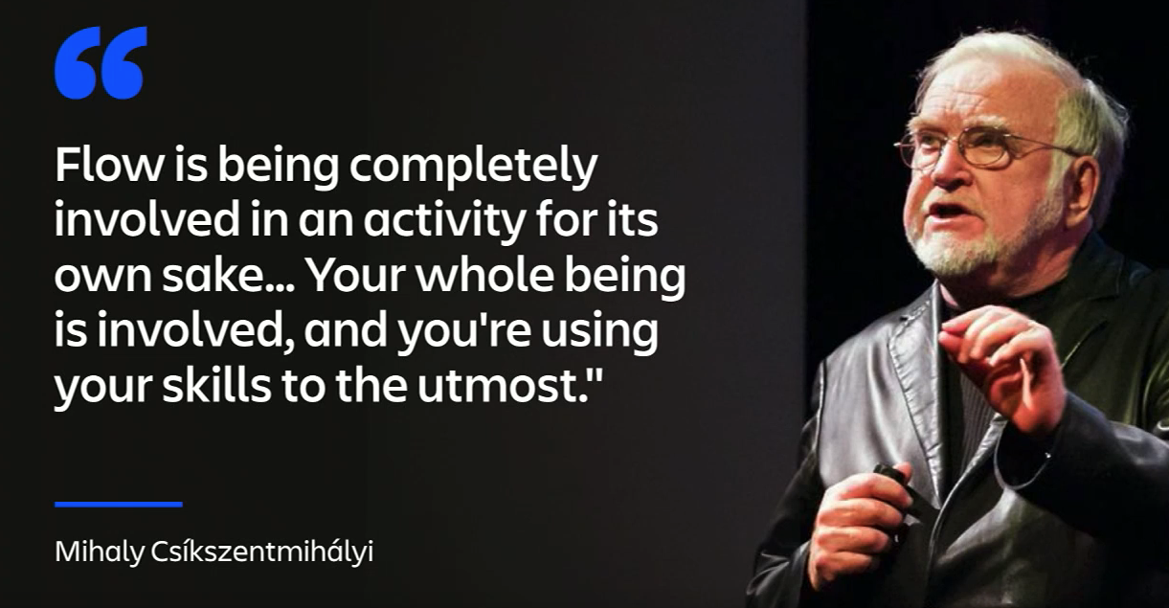
The Art of the Flow - Doing is Being
Mindset - Mental State of Being
Similarly - Sports, Art, Spirituality, Hobbies & Play
“Being in the zone”
“Lost in the craft”
“Shu Ha Ri” - Japanese martial art concept
describing the stages through progression to mastery
Optimal Agile Experience: The most enjoyable moments in life are not the moments of leisure and relaxation --- Those moments are full of challenge - even pain
Counterintuitive!
Source: Shu Ha Ri - Joyce Vargas
Notes:
https://www.youtube.com/watch?v=EXlMy9jE5ro
It can be something as small as washing the dishes.. Or reading.. Or as big as going to the olympics

Slide 6
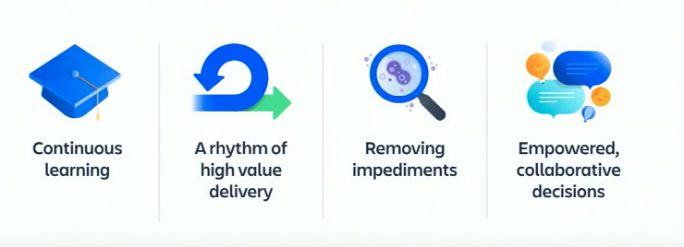
The Art of the Flow - Continuous Improvement
Agile - “Growth Mindset” - A set of principles that help us work towards flow and mastery - Learning is at the core of attaining flow
Continuous Learning - Constant inspection of reality - “Inspect what is Expected”
Adapting to a rhythm of “high value (and velocity) delivery”
Removing obstacles and friction, with focus on outcomes
Team members make shared, educated decisions
Source: Shu Ha Ri - Joyce Vargas

Slide 7
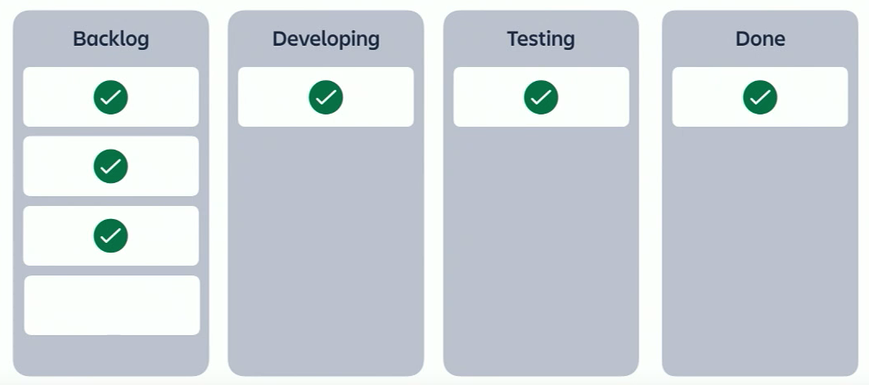
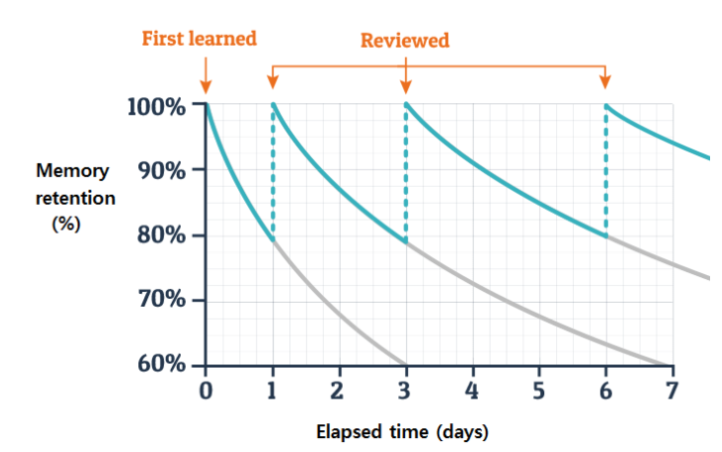
The Art of the Flow - Doing is Being
“Doing” - Delivery of Value
JIRA Board - Visual tools track value of deliverables
Solutions & ideas deliver value from end-to-end
if not preserved, or available, diminish value
Daily standups (reviews) are designed to maintain value, expose and remedy impediments (roadblocks)
Successes are celebrated by achievements (deliverables), with a safe space for feedback and praise
Source: Ebbinghaus - Wikipedia

Slide 8
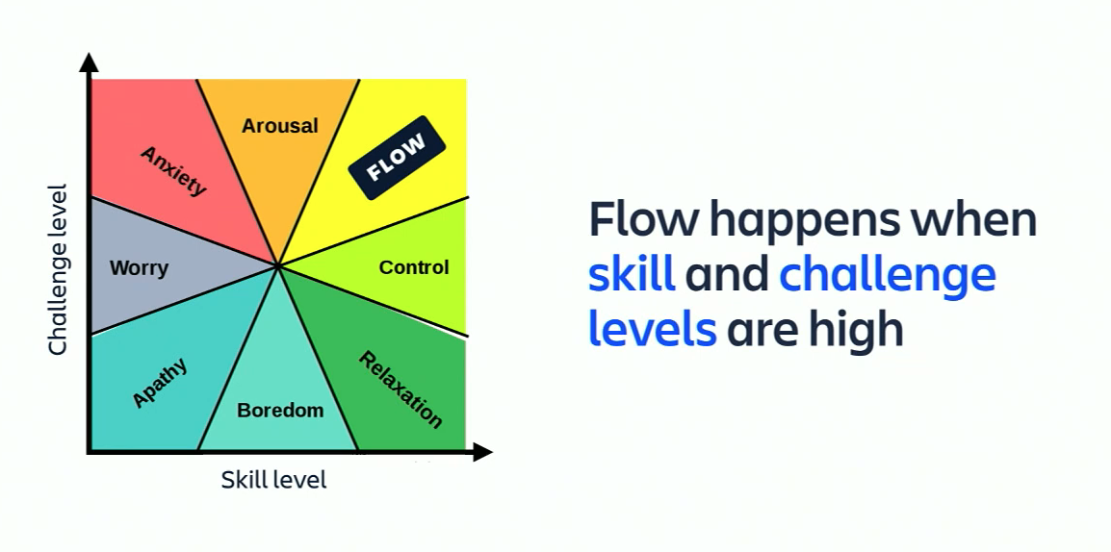
The Art of the Flow - Doing is Being
Doing something not challenging, that does not require skill leads to boredom
Something super-challenging, managed entirely by one’s self leads to anxiety
Without the support of the team and servant leadership, anxiety is all-consuming – a productivity killer
Equality
Source: Shu Ha Ri - Joyce Vargas
Notes:
https://www.youtube.com/watch?v=EXlMy9jE5ro

Slide 9
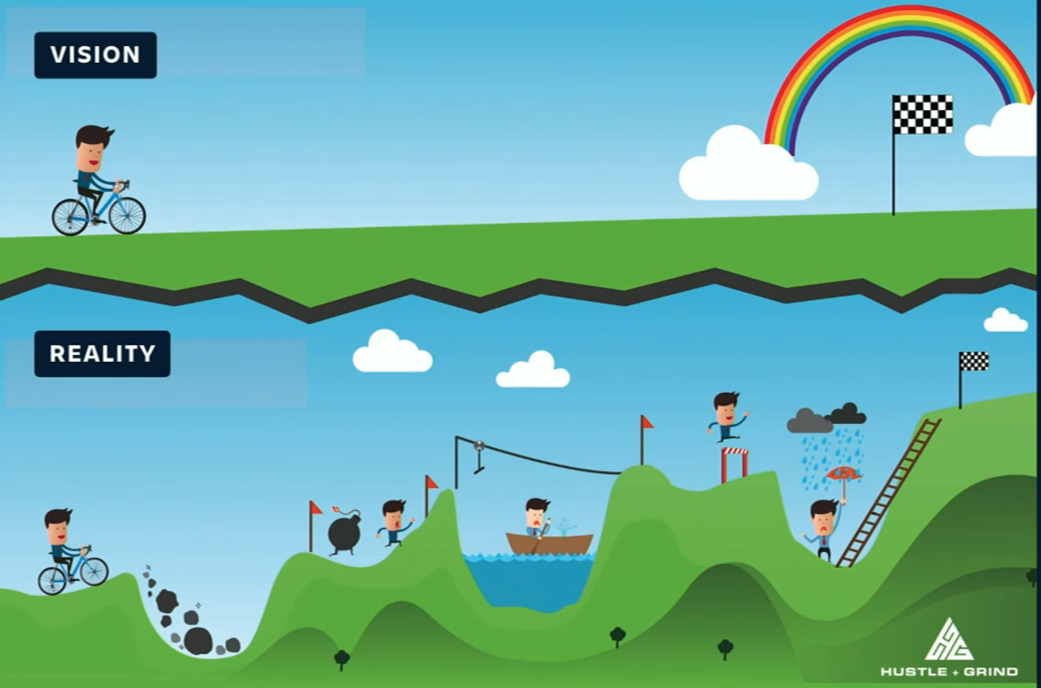
(Team) - The Art of the Flow -
Continuous Improvement
Agile is designed for flexibility in a changing environment.
There is no absolute and final destination for the team.
The work does not end at delivery
We all have ambitious goals with our projects
Our skills get better as we gain mastery of the terrain - and continue.
Source: Shu Ha Ri - Joyce Vargas

Slide 10
Team - The Art of the Flow - Continuous Improvement
Waterfall
Expectations span the entire duration
Requirements are finite and managed upfront
Teams are oganized and managed throughout process
Agile
Teams adapt to changing conditions, and user requirements
Re-prioritization built into the process
Short release cycles for constant learning and improving
Trust & Visibily into progress
Teams are self-organizing and autonomous - they function as a single unit
Source: Shu Ha Ri - Joyce Vargas

Slide 11
Team - The Art of the Flow – HOW DO WE GET THERE?
Establish rhythm and inspect impediments.
Remove impediments to reduce friction.
Less friction leads to higher morale & engagement.
Higher engagement empowers teams.
Delivery and value increase as teams’ worth increases.
Source: Shu Ha Ri - Joyce Vargas

Slide 12
Agile Maturity - Transformation from "doing agile" to "being agile"
Learning Balance of Doing and Being Remove anxiety Educate together | Rhythm Servant Leadership Continuous improvment
Removing Impediments Focus on outcome, not hours of output Anxieties | Empowered Collaboration Sharing & Availability (if a person is not available, their thoughts should be) Purposeful solution-based meetings
Source: Shu Ha Ri - Joyce Vargas

Slide 13
Agenda
Kanban
Leadership
Development
Agility

Slide 14
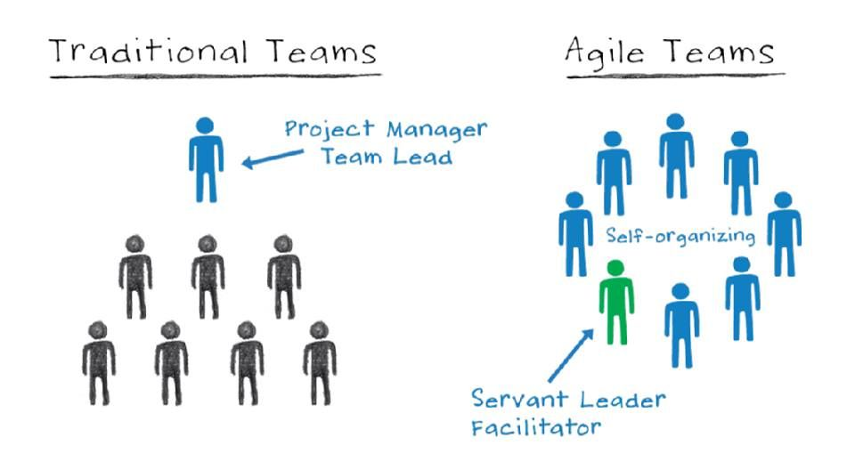
Leadership
SCRUM MASTER - AKA “Servant Leadership”
Helps those outside the Scrum Team understand which of their interactions with the Scrum Team are helpful, and which are not.
The Scrum Master helps everyone change these interactions to maximize the value created by the Scrum Team.
Source: David Hawks - Agile Velocity

Slide 15
Leadership – Duty of Scrum Master
Scrum Master Service to the Product Manager/Owner/Analyst
Ensuring that goals, scope, and product domain are understood by everyone on the Scrum Team (as well as possible)
Product Backlog management
Product planning
Facilitating Scrum events
Scrum Master Service to the Development Team
Coaching the Development Team in self-organization and cross-functionality;
Helping create high-value products
Removing impediments to the Development Team’s progress
Facilitating Scrum events as requested
Source: David Hawks - Agile Velocity

Slide 16
Leadership
Three Factors -
Better Performance & Personal Satisfaction
Agile mindset as a team:
Autonomy – Successfully using the culture to work
Purpose – What the product means to the team. What the team achieves
Mastery – Agile framework is heuristic; it’s based on continuous learning

Slide 17
Trust Impacts Team Self-organization
SCRUM TEAMS:
Product Owners, the Development Team, and Scrum Master.
Self-organizing teams - choose how best to accomplish their work, rather than being directed by others outside the team.
Cross-functional teams - have all competencies needed to accomplish the work without depending on others not part of the team.
The team model in Scrum is designed to optimize flexibility, creativity, and productivity
Source: David Hawks - Agile Velocity

Slide 18
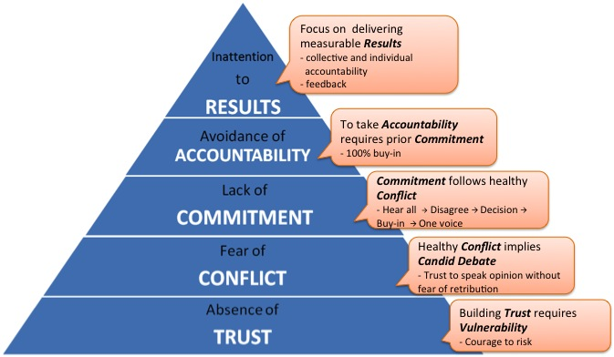
Trust Impacts Team Self-organization
Trust – Team members trust one another
Conflict (HEALTHY) – they engage in unfiltered conflict around ideas.
Commitment – they commit to decisions and plans of action.
Accountability – they hold one another accountable for delivering against those plans
Results focus – they focus on the achievement of collective results
Source: David Hawks - Agile Velocity

Slide 19
Agenda
Kanban
Leadership
Development
Agility

Slide 20
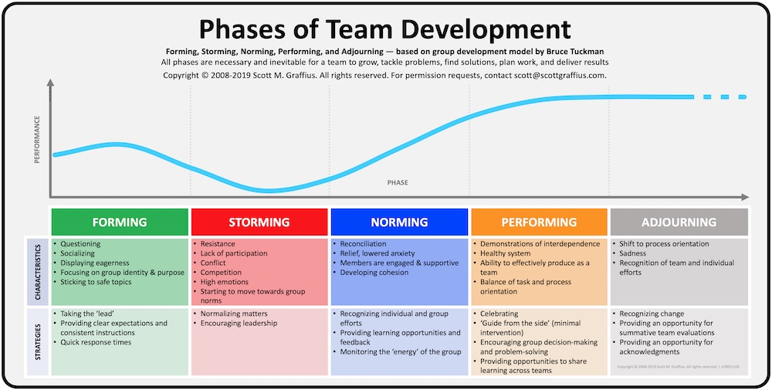
Development - How Do Teams Form?
Source: Tuckman’s Model of Team Dynamics

Slide 21
Stages of Team Development
Forming
In this stage, most team members are positive and polite.
Some are anxious, as they haven't fully understood what work the team will do. Others are simply excited about the task ahead.
The leader will play a dominant role at this stage, because team members' roles and responsibilities aren't clear.
This stage can last for some time, as people start to work together, or as they make an effort to get to know their new colleagues.
Source: Tuckman’s Model of Team Dynamics
Notes:
Agile Velocity - ACSM Manual

Slide 22
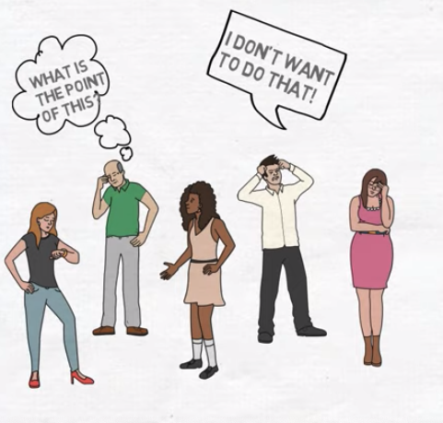
Stages of Team Development
Storming
Next, the team moves into the storming phase, where people start to push against the boundaries established in the forming stage.
This is the stage where many teams fail.
Storming often starts where there is a conflict between team members' natural working styles. People may work in different ways for all sorts of reasons but, if different working styles cause unforeseen problems, they may become frustrated.
Team members may challenge authority, or jockey for position as their roles are clarified. People may feel overwhelmed by their workload, or they could be uncomfortable with the approach leadership is using.
Some may question the worth of the team's goal, and they may resist taking on tasks.
Source: Tuckman’s Model of Team Dynamics
Notes:
Agile Velocity - ACSM Manual

Slide 23
Stages of Team Development
Norming
Gradually, the team moves into the norming stage. This is when people start to resolve their differences, appreciate colleagues' strengths, and respect direction and leadership.
Now that the team members know one another better, they may socialize together, and they are able to ask one another for help and provide constructive feedback. People develop a stronger commitment to the team goal, and we start to see good progress towards it.
There is often a prolonged overlap between storming and norming, because, as new tasks come up, the team may lapse back into behavior from the storming stage.
Source: Tuckman’s Model of Team Dynamics
Notes:
Agile Velocity - ACSM Manual

Slide 24
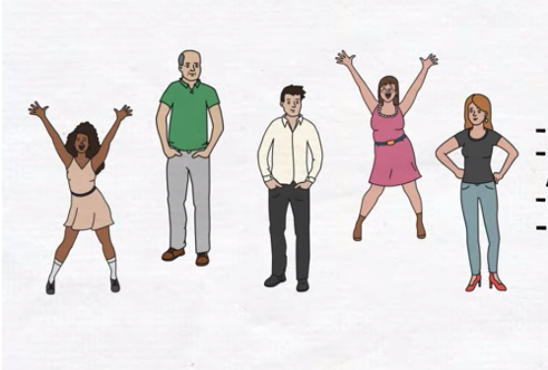
Stages of Team Development
Performing
The team reaches the performing stage, when hard work leads, without friction, to the achievement of the team's goal. The structures and processes that you have set up support this well.
As leader, you can delegate much of your work, and you can concentrate on developing team members.
It feels easy to be part of the team at this stage, and people who join or leave won't disrupt performance.
Source: Tuckman’s Model of Team Dynamics
Notes:
Agile Velocity - ACSM Manual

Slide 25
Stages of Team Development
Adjourning
Many teams will reach this stage eventually.
For example, project teams exist for only a fixed period, and even permanent teams may be disbanded through organizational restructuring.
Team members who like routine, or who have developed close working relationships with colleagues, may find this stage difficult, particularly if their future now looks uncertain.
Source: Tuckman’s Model of Team Dynamics
Notes:
Agile Velocity - ACSM Manual

Slide 26
Stages of Team Development
SUCCESSFUL TEAMS - GROUP DEVELOPMENT - GOLDEN RULES
Rotate the responsibility of group facilitation
The purpose and mission of the group must remain clear
Ground rules should be established and monitored
“Conflict is a normal” - and sometimes necessary piece
The groups is reminded to listen to each other
Wrap-up of each session is comprised using meaningful and constructive comments
Enable the group to be a “learning team”
PERFORMANCE & GOALS - OVER TIME
Tasks for projects can be delegated far out into the future
Team members can work independently
Scrum Masters can begin to focus on other teams and other projects - other goals and areas of work
Notes:
Agile Velocity - ACSM Manual

Slide 27
Agenda
Kanban
Leadership
Development
Agility

Slide 28
Path to Agility - “Just get started, then get better” - A. Hudson
Avoid making hard decisions at your dumbest point
When we begin a project, we rarely have a complete idea of what it takes to complete it or even if the requirements are 100% accurate.
Yet, we still want to plan right down to the second. Don’t fall into this trap, even if having a precise plan gives you and stakeholders comfort.
The more precise a plan is in the beginning is, the more than often it is greatly inaccurate, when compared to the outcome of a finished project.

Slide 29
Path to Agility - Project Conception & Kickoff
What is Product Requirement Document (PRD)?
Definition of product or system functionality, and the associated benefits
Includes core objective, the customer, true value, users and their interactions, design, success criteria
Additional information: (project dependant & optional): client expectations & assumptions, risk, design or user stories, technical dependencies, timeline, cost, cost savings, developer & associate hours, etc
Contains all the requirements for a product so that the product development team can understand what that product should do, as well as the definition of “done”.
Died with Waterfall….
Is it still essential? Absolutely!
It is the platform to initiate a project
The list of individual work tasks, order of operations and artifacts to serve and support the initial scrutiny
The lists can be broken down into their essential functional modules and parts
Defines “done”
Can be referenced and used by supporting teams as “Product Documentation”
How do we approve a PRD?
Reviewed by leadership.
Break it down into its workable parts
… but why build something just to take it apart?

Slide 30
Forecast with periodic inspection and adaptation
In Agile, we acknowledge that we don’t have perfect requirements in the beginning of the project.
We still create a plan and begin to execute towards the goal.
Here is where agile planning differs from traditional waterfall planning:
With agile planning, we inspect how everything is going as we make progress
We adapt the plan based on new information until the definition of “done” is reached
Planning is a means to an end, and should never be a project in itself (In Waterfall the project is the plan)
Backlog Refinement & Readiness
Saves time and money by ensuring that its items are ready for development at the right time
Performed 2-3 sprints ahead with PBIs in “Ready” status
Stories are scrubbed and updated with the most recent and relevant information
“Ready” PBI’s must meet the INVEST criteria

Slide 31
INVEST
I - Independent (of all others) - Zero dependence on other pieces, can be worked on alone, working software is obtained with a single item
N - Negotiable (not a contract of features) Prompts, not prescribes a shared understanding between PO and Dev members. It is an evolving conversation between the PO that understands benefits and Dev that understand the best way to build
V - Valuable (or vertical) - Benefits are clear. Stories state the value they bring, risk mitigated, costs saved and learnings allowed
E - Estimable (to a good approximation) - Enough detail provided to estimate and size task
S - Small (fits within an iteration) - Smallest piece of work that will deliver useful software
T - Testable (in principal, even if tests do not exist yet) - Clear enough that “done” can be assessed. Yes or No criteria can be used to check for acceptance

Slide 32
As we get bigger… How do we scale scrum without losing strength? Multiple flavors of Scrum!
There are no such things as best practices. There are only practices that are good within a certain context
We don’t want more roles because more roles leads to less responsibility within Teams.
We don’t want more artifacts because more artifacts leads to a greater distance between Teams and customers.
We don’t want more process because that leads to less learning and team ownership of process.
We want more responsible Teams by having less (fewer) roles
We want more Team ownership of process and more meaningful work by having less defined processes.
We want more with less.
Source: LeSS Framework
Notes:
Traditional sequential-lifecycle development doesn’t work well. It doesn’t work well for either small or large product development efforts. Since 2001, Agile development and Scrum in particular have revolutionized software development, but when asked how to apply Agile development to large groups many people say “don’t” or “just use a small team” or “do Scrum at the team level.” None of those answers is particularly useful, and while it is true that it is best to avoid adding people to your development effort, it is also true that large scale product development isn’t going away so we need to discover ways to do it well.

Slide 33
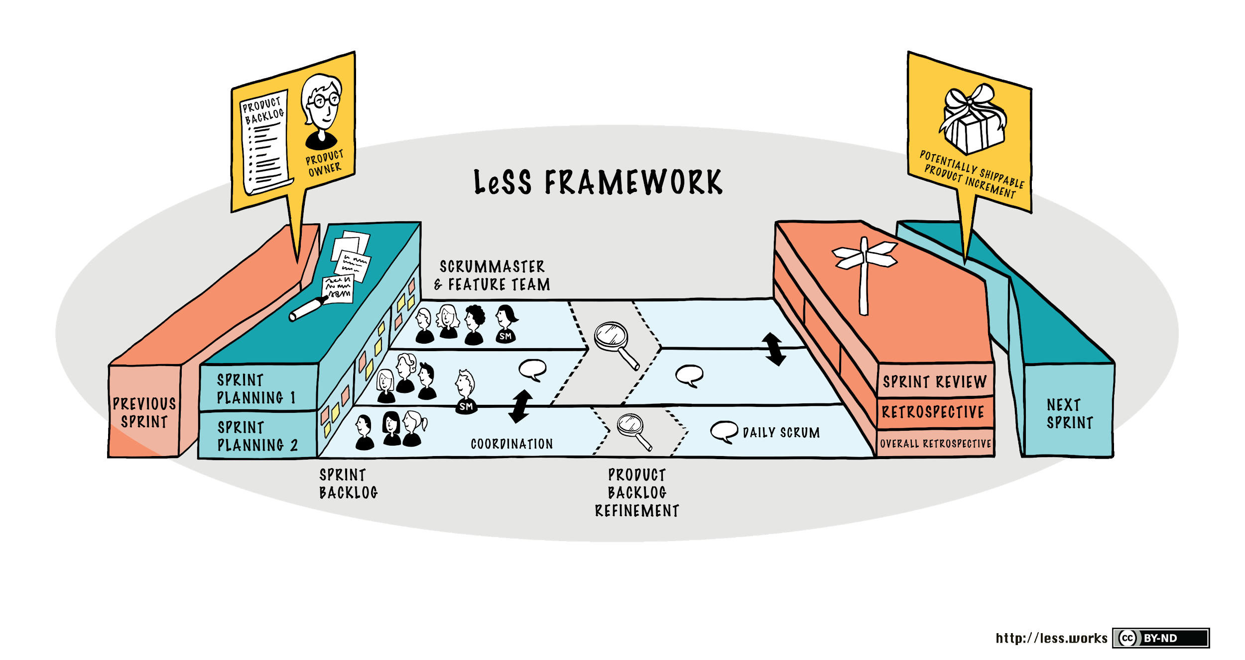
Option: LeSS (Large-Scale Scrum) is Better?
Framework:
Roles:
(1) Product Owner
(2-8) Devs
(1) Scrum Master for (1-3) teams
Multiple teams for “Requirement areas” (Feature teams, modules)—true cross-functional and cross-component teams.
Single PO, backlog, definition of “done” for all
Each team maintains focus on their own work
Works together in shared environment
(1) common Backlog across all teams
(1) common Sprint across all teams
(1) shippable Product increment
Source: LeSS Framework
Notes:
Challenge the leadership to come up with the most effective scrum framework for the COPS group - without the systems, checks, rechecks, siloed work

Slide 34
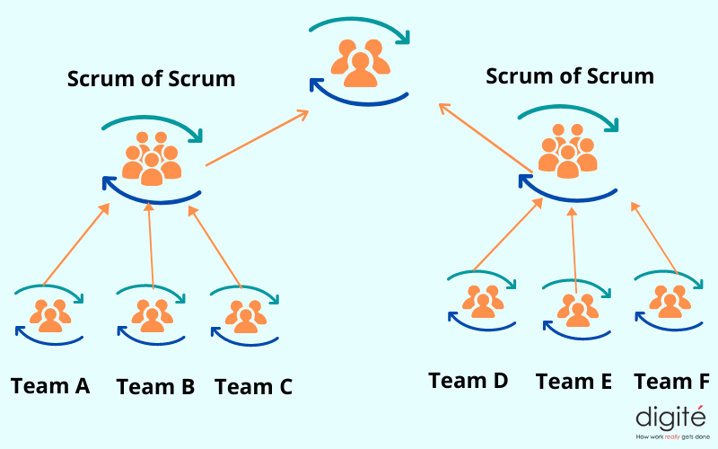
Option: Scrum of Scrums is Better?
Framework:
Roles:
(1) Product Owner
(2-8) Devs
(1) Scrum Master in each team
Coordinating the work of smaller scrum teams with a larger scrum team
Requires that each individual team be a high-performing scrum team.
Teams each name an “ambassador” to participate on the scaled version of the daily standup.
New role is the scrum of scrums master, which is simply a scrum master, but at a higher level.
Multiple Backlogs
Individual Sprints across all teams
Individual Product increments
Source: https://www.digite.com/agile/scrum-of-scrums/
Notes:
Challenge the leadership to come up with the most effective scrum framework for the COPS group - without the systems, checks, rechecks, siloed work

Slide 35
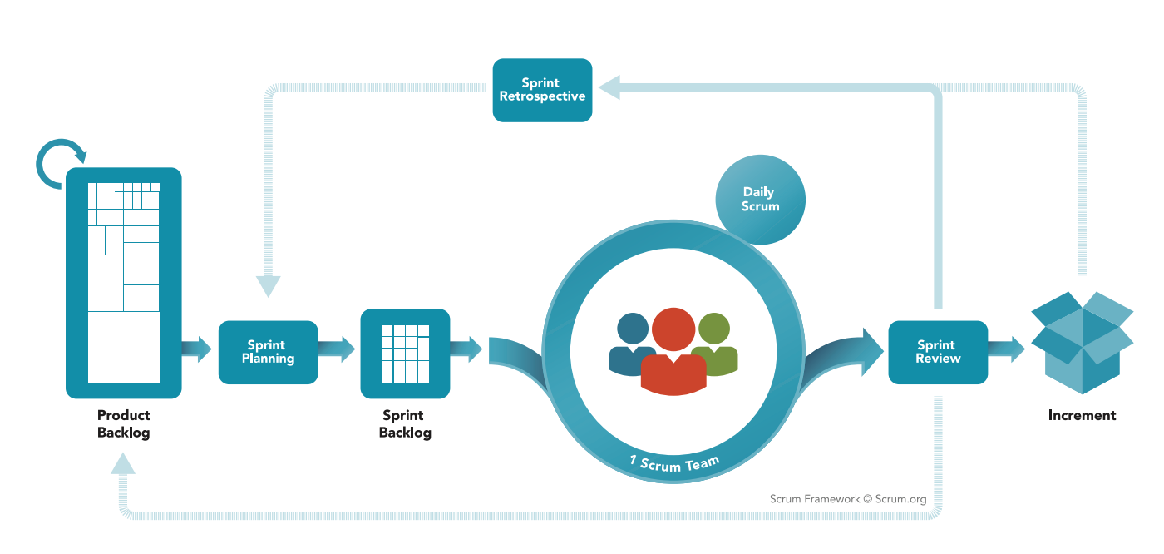
Grooming (learning as a team)
Many Iterations of Agile!
What will work best for GT & PHX?
Agile is a mindset.
Scrum is a framework for getting work done
Agile takes dedication from the whole team to change the way they think about delivering value
Scrum framework is heuristic; it’s based on continuous learning and adjustment to fluctuating factors
Scrum helps to build Agile principles into everyday communication and work.
Scrum helps teams adapt to changing conditions and user requirements, with re-prioritization built into the process, and short release cycles for constant learning and improving.
Source: Scrum.org

Slide 36
FIN.

Slide 37
The Scrum Guide - https://scrumguides.org/scrum-guide.html
Agile Manifesto Values - http://agilemanifesto.org/
Kanban - http://www.everydaykanban.com/what-is-kanban/
User Stories - https://www.mountaingoatsoftware.com/agile/user-stories
Scaling Frameworks:
Large-Scale Scrum - https://less.works/ & https://www.digite.com/agile/scrum-of-scrums/
Scrum at Scale - https://www.scrumatscale.com/scrum-at-scale-guide-read-online/
Sources & Additional Info

